Slide 1
Line Of Credit
Line of Credit – Byline Bank
Amount of Line of Credit -$15M
Interest Rate- 30 Days SOFR plus 120 bp
Current Rate – 6.52%
Estimated Monthly Interest Cost $81,500
True Interest cost on GO Bonds- 4.20%
Current Interest on City Checking Account- 5.50%
1

Slide 2
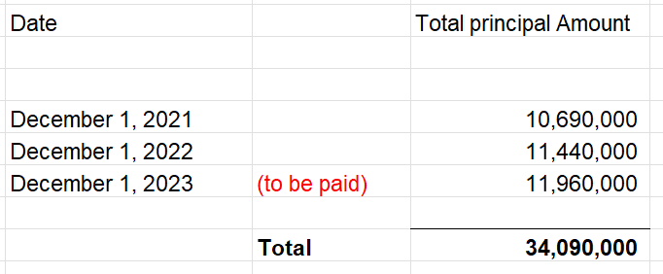
GO Bonds Details
Last GO Bond Sale Date – August 23, 2021
Last GO Bond Sale Amount- $14,420,000
Total GO Bond Principal Amount (Debt) Paid since the last issue
2

Slide 3
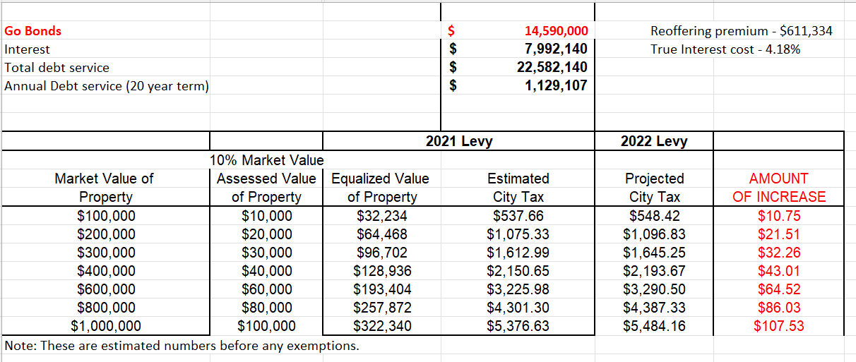
G.O. Bonds
Summary as of 08/24/2023
3

