Slide 1
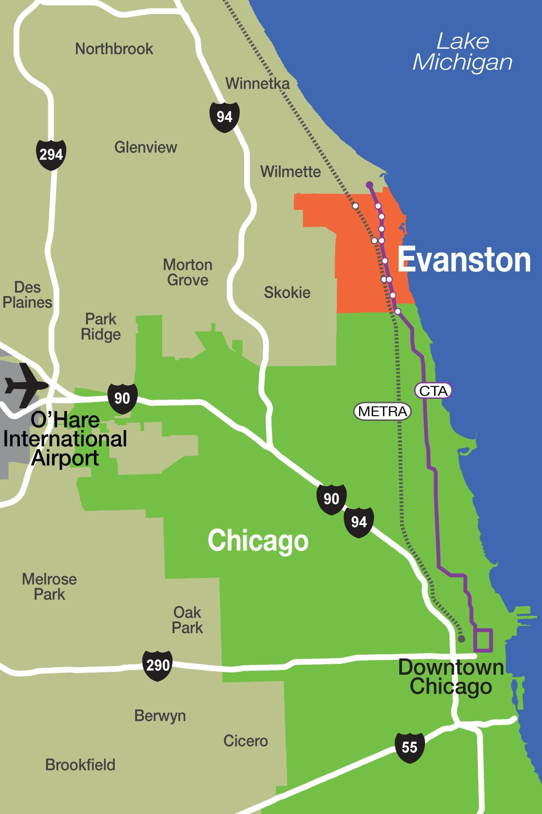
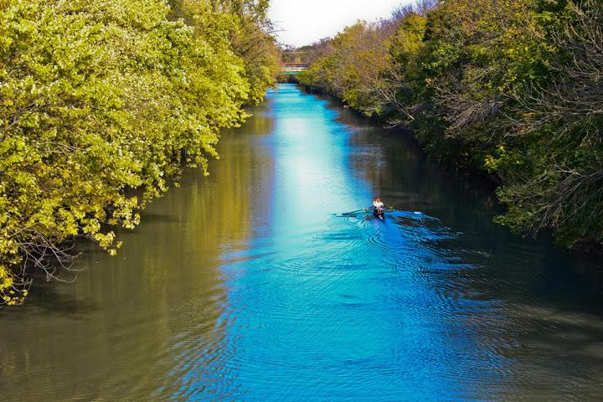
EVANSTON
2020-21 Proposed Budget Discussion
November 11, 2019

Slide 2
BUDGET MEMOS
Available on at www.cityofevanston.org/budget
Items for discussion:
Vacant property registration
Parking - $2 on-street and Sunday parking
Amusement tax and hotel tax
Reimbursement for Police and Public Works services

Slide 3
VACANT PROPERTY
Staff proposal:
Increase existing vacant building registration fees from $400 to $2,500 on January 1, 2020
Add fee for additional inspections of vacant properties ($250 per; current initial inspection for registration is $500)
Increase penalties for violation of vacant building ordinance: $250 for first violation, $750 for second, $1,000 for third

Slide 4
VACANT PROPERTY
Staff proposal:
Properties that are unoccupied but not vacant per City Code: codify a requirement that these properties register with the City, with $25 registration fee.
Monitor Cook County Assessor’s efforts to modify valuation and assessment of vacant properties.

Slide 5
ON-STREET PARKING
Increase from $1.50 to $2 per hour expected to generate $1.5M to $1.9M in new revenue for Parking Fund
Eliminating Sunday parking charges would cost $260,000 to $300,000 in lost revenue

Slide 6
OTHER TAXES
Staff does not recommend expansion of the amusement tax to health club memberships or classes at this time.
Increase in amusement tax from 4% to 5% is on the agenda for the November 18 meeting
Hotel tax - increase of 0.5% would yield $125,000 to $150,000. Current rate is 7.5%

Slide 7
SERVICE REIMBURSEMENTS
City does not currently receive reimbursements for Public Works employees during NU home football games.
Average cost per game is $1,000 - two employees, 10-11 hours overtime each
Police details during NU games are reimbursed, at 1.5 time officers’ pay rate. City does not collect an administrative fee on top of this amount.
A tiered fee of $50-$200 could be added to all special details to cover administrative costs.

Slide 8
UPCOMING DATES
Mayor’s Town Hall - November 14, 7 p.m., Temperance Beer Co. (2000 Dempster Street)
November 18 City Council Meeting
Introduction of budget ordinance and tax levies
Introduction of new revenues included in 2020 Proposed Budget
November 25 City Council Meeting
Anticipated adoption of budget ordinance and tax levies

Slide 9
MORE INFORMATION
Budget Website: cityofevanston.org/budget
Form to submit additional questions and feedback, or email budgetinquiries@cityofevanston.org
Budget Memos - more detail on proposals and answers to questions asked during the City Council discussions
Direct link:
https://www.cityofevanston.org/home/showdocument?id=52072

