Slide 1
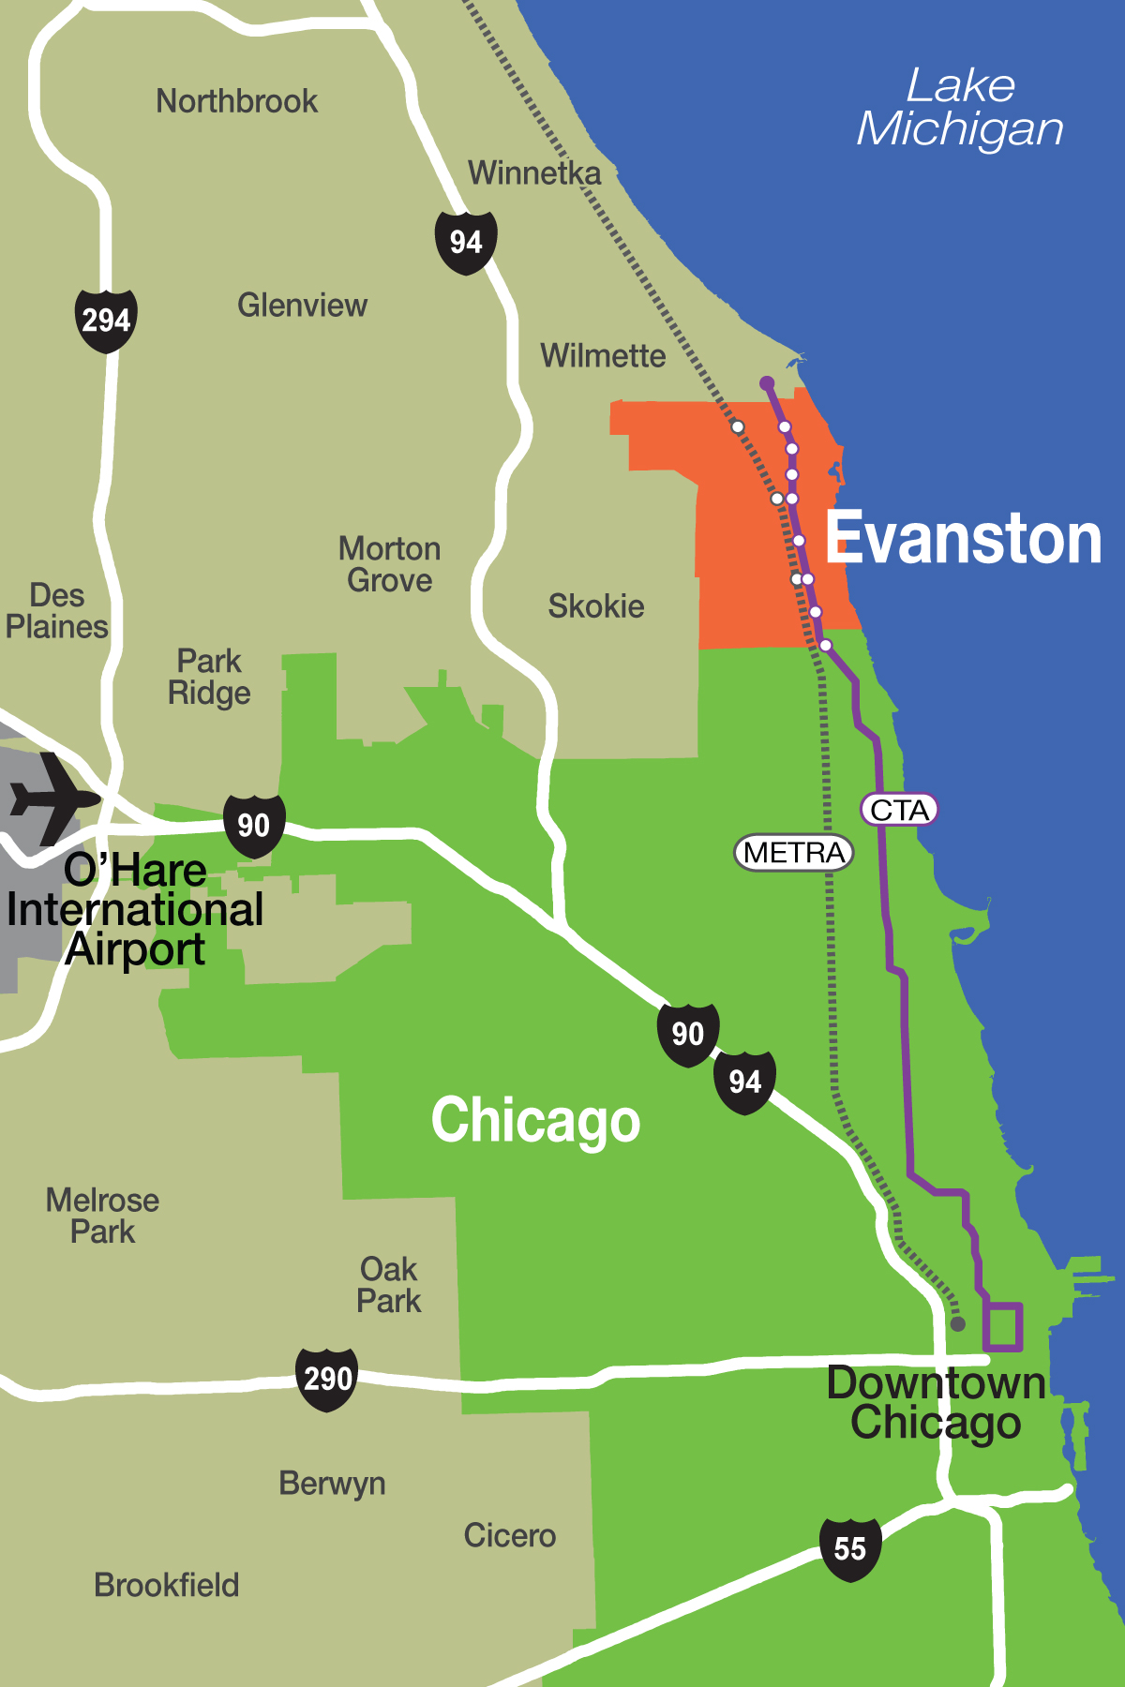
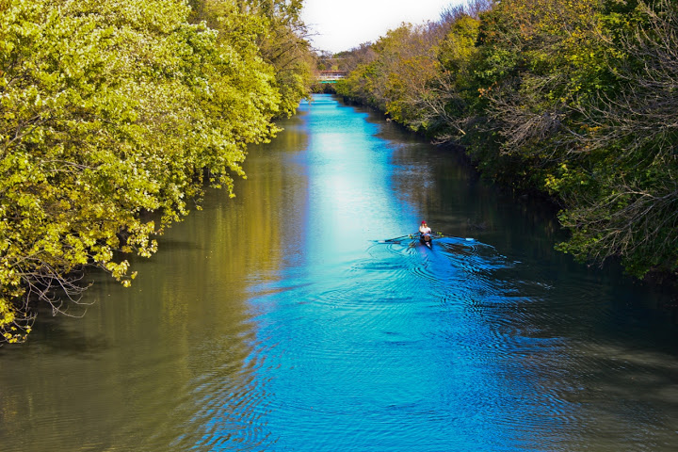
Evanston
FY 2018 Proposed Budget Presentation
2nd and 4th Ward Joint Meeting
October 26, 2017

Slide 2
Fy 2018 Budget Presentation
Today
FY 2018 Budget Overview
Budget Balancing Worksheet Proposals
Upcoming Meetings
October 28, 2017 – Public Hearing, 9 am

Slide 3
Fy 2018 ALL FUNDS Overview
All Funds Total Budget -- $338,888,344
Increase over 2017 -- $33.4M or 13.5%
Major increases:
Library Capital-- $6.3M increase
TIFs-- $4M increase
Crown Capital-- $9.6M increase
Water Fund-- $16M increase

Slide 4
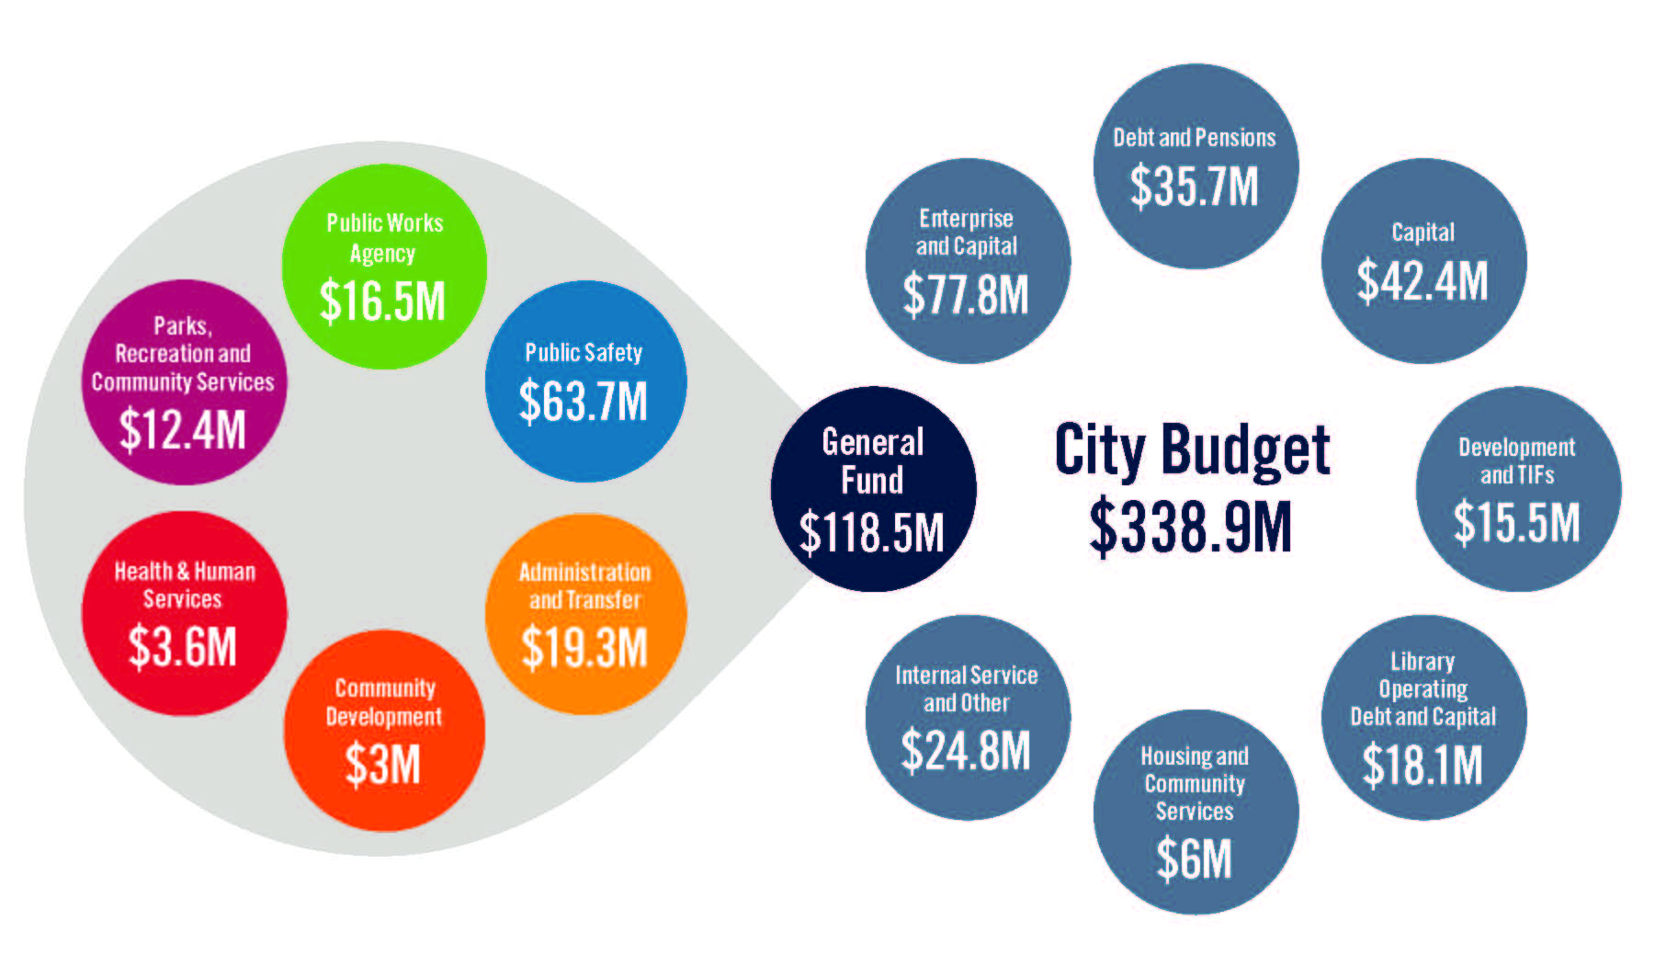
Fy 2018 ALL FUNDS Overview

Slide 5
Fy 2018 ALL FUNDS Overview
Water Fund
7% increase in Water rate
4% decrease in Sewer rate
Net 0% increase to customers
Begin selling water to Morton Grove & Niles – November 2018 at earliest

Slide 6
Fy 2018 ALL FUNDS Overview
Crown Capital Fund
New with 2018 Budget
Included in the Capital Improvement Plan
Funds raised by Friends of Robert Crown to be used in 2018-2020 construction budgets

Slide 7
Fy 2018 ALL FUNDS Overview
Parking Fund
2018 to include an evaluation of new Transportation and Parking Fund
Expanded goals and resources to cover all transit and parking issues

Slide 8
Fy 2018 proposed budget
General fund baseline
Baseline Budget
$112.4M in Revenues
  $5.0M decrease in building permit revenue
  3% decrease in sales tax
  10% decrease in state income tax
$118.5M in Expenses
  3% general wage increase
  All current staffing levels
Results in $6.1M deficit

Slide 9
Fy 2018 proposed budget
General fund baseline
Baseline number is used throughout the 2018 Proposed Budget document.
Deficit is proposed to be solved by a number of solutions presented on page 17- 19 of the 2018 Proposed Budget document.

Slide 10
Fy 2018 PROPOSED BUDGET
Tax Levy
The Budget Balancing Worksheet proposes a $421,742 property tax as noted below
  Police Pension Levy Increase: $225,504
  Firefighters Pension Levy Increase: $196,238
  $421,742
The City Council has also reviewed an increase of $410,000 or 1.0% of the City’s tax levy to cover Solid Waste Services for 2018.

Slide 11
Fy 2018 ALL FUNDS Overview
Tax Levy
Impact on Individual Homeowner: For every $100K of market value, tax levy will increase by $4.54.

Slide 12
Fy 2018 proposed budget
Budget balancing options
Proposed Position Reductions
  28.3 Full-time equivalent (FTE) reductions
  5.5 FTE Additions
  7.0 FTE Vacancies held open (Public Safety)
  26.8 Net reduction in positions
4% Reductions – All Departments

Slide 13
Fy 2018 proposed budget
Budget balancing options
Proposed Reorganizations
Merge Fleet Services and Facilities Management Divisions in Administrative Services Department
Move Economic Development Division from City Manager’s Office to Community Development Department
Police Department Social Services Bureau responsibilities to move to Health and Human Services Department
Merge Environmental Services and Infrastructure Maintenance Bureaus to created new Public Services Bureau in Public Works Agency

Slide 14
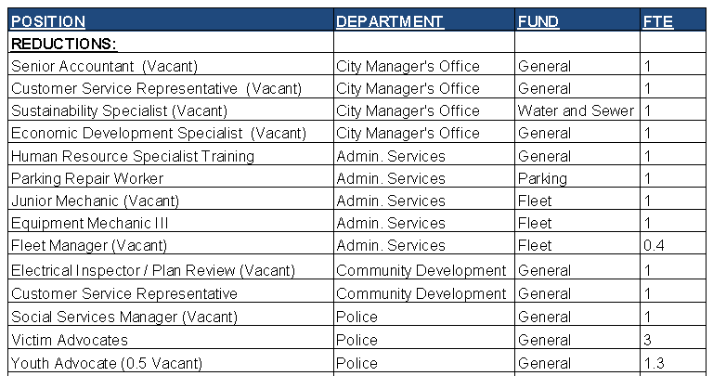
Fy 2018 proposed budget
Position changes - REDUCTIONS

Slide 15
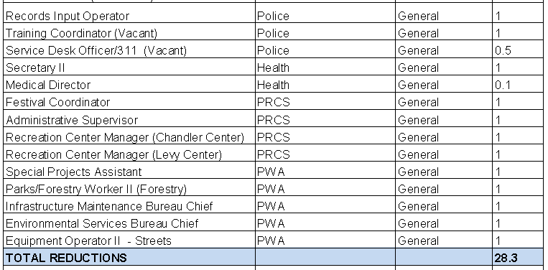
Fy 2018 proposed budget
Position changes - REDUCTIONS

Slide 16
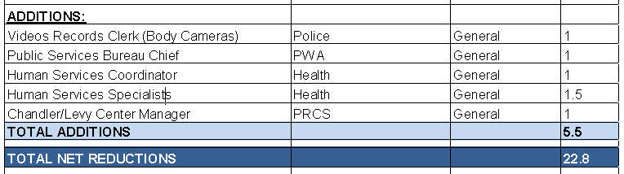
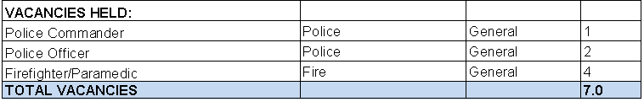
Fy 2018 proposed budget
Position changes - ADDITIONS & VACANCIES

Slide 17
Fy 2018 proposed budget
Budget balancing worksheet revenues

Slide 18
Fy 2018 proposed budget
Budget balancing worksheet EXPENSEs

Slide 19
Fy 2018 proposed budget
Budget balancing worksheet EXPENSEs

Slide 20
Fy 2018 proposed budget
Budget balancing worksheet EXPENSEs

Slide 21
Fy 2018 proposed budget
Budget balancing worksheet EXPENSEs

Slide 22
Fy 2018 proposed budget
Budget balancing worksheet expenses

Slide 23
Fy 2018 proposed budget
Budget balancing worksheet totals

Slide 24
Fy 2018 proposed budget
Next steps
City Council Meeting – October 23, 2017
  Capital improvements plan overview
  Presentation can be found on budget website:
  www.cityofevanston.org/budget
Public hearing – October 28, 2017, 9 a.m.
  Proposed budget hearing
  Truth in Taxation Hearing – 2017 Tax Levy

Slide 25
Fy 2018 proposed budget
Capital Improvements Plan
2nd and 4th Ward Projects Included:
  Mason Park – Roofing/exterior improvements
  Sewer – Large diameter rehab, Greenleaf
  Dodge Avenue Bus Stop Pilot
  Alley improvements
    North of Grove, East of Dodge
    North of Davis, East of Dodge
    North of Church, East of Darrow
  Citywide projects
    Police body cameras
    Street patching, lighting, pavement marking
    Traffic calming, bicycle, and pedestrian improvements

Slide 26
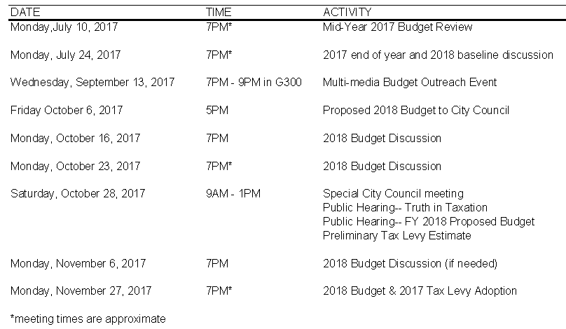
2018 BUDGET CALENDAR

Slide 27

Fy 2018 proposed budget
questions

